Slide 1
Non-irrad Module Test KEK101-KEK104(Ni/In)

Slide 2
Overview
磁場耐性試験用 Ni/In bump-bonding moduleの試験を行った (KEK101,102,103,104)
試験内容
Before Thermal Cycle: tuning & source scan
After Thermal Cycle: tuning & source scan
KEK102~104に関してはTC後もtuning & bump statusともに異常なし
KEK101はTC後にbump open

Slide 3
Overview
KEK102~104に関してはTC後もtuning & bump statusともに異常なし
KEK101
RJ4のregister1が壊れていた（Thresholdを合わせるときにVthinを変えてもtuningできなかった）
TC後にbump open
→全moduleについてまとめていないのでKEK101についてのみ

Slide 4
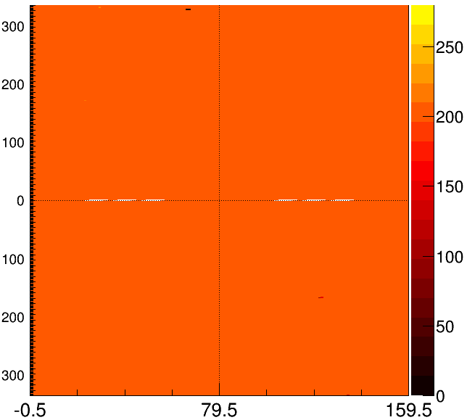
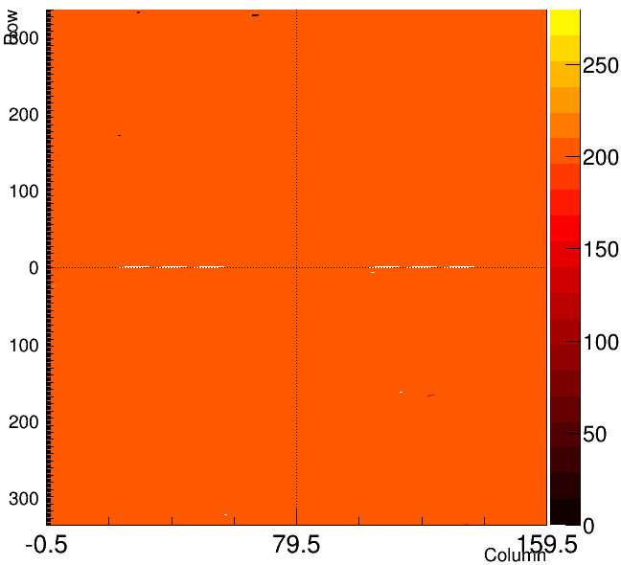
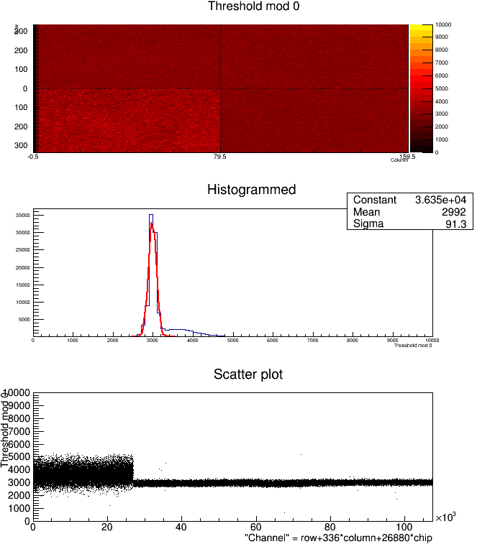
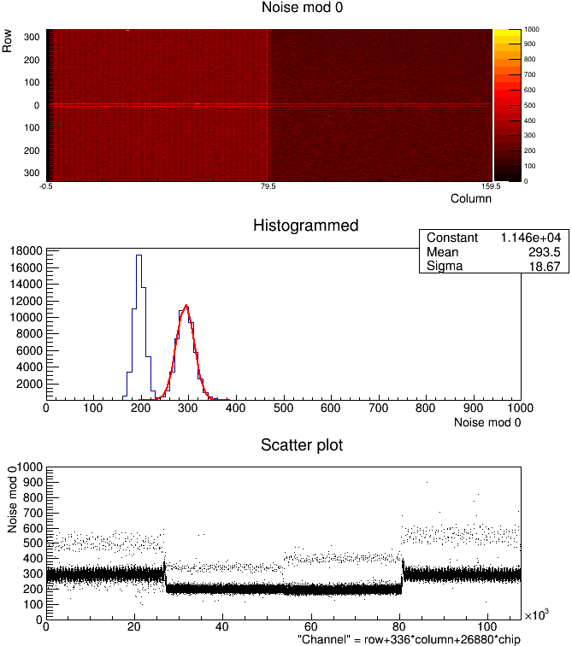
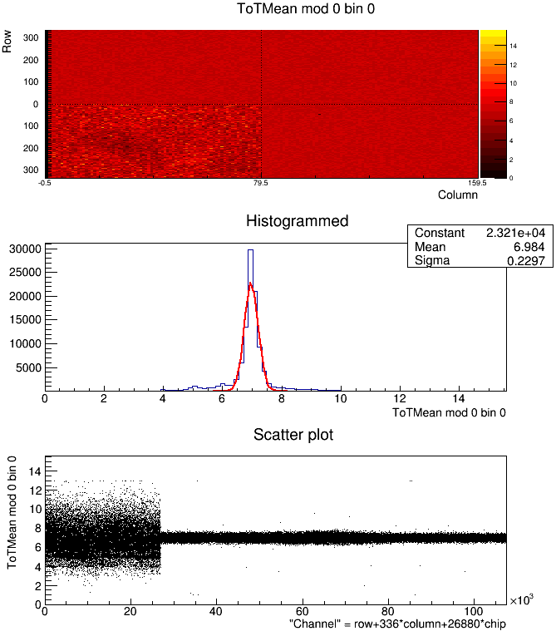
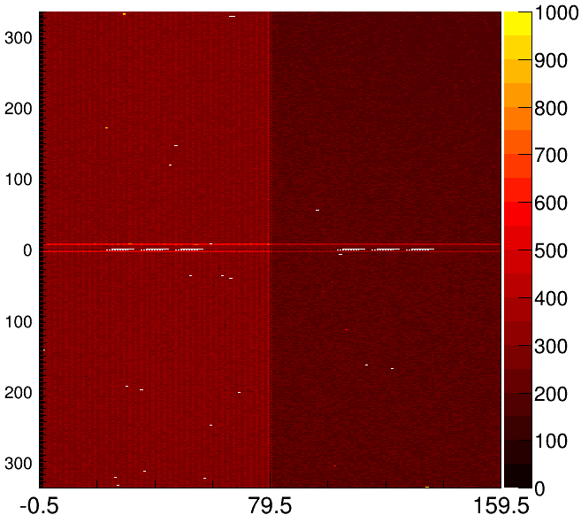
KEK101 Tuning (before TC)
Digital Test | Analog Test | Threshold Mean
Threshold Sigma | TOT Verif | Threshold sigma map

Slide 5
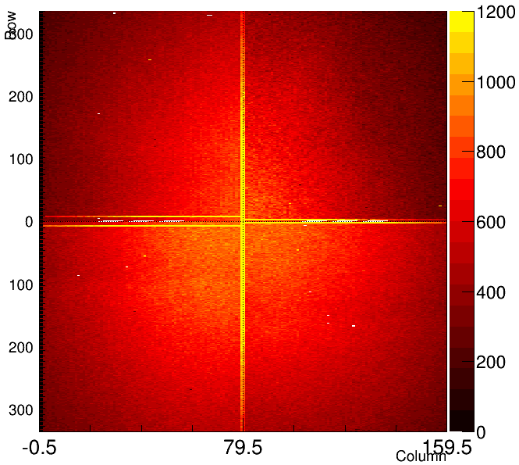
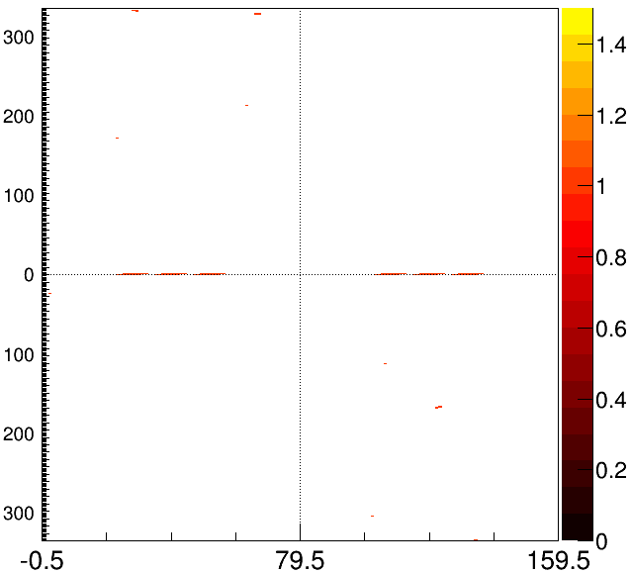
KEK101 Source Scan (100V)
Source Scan | Mask

Slide 6
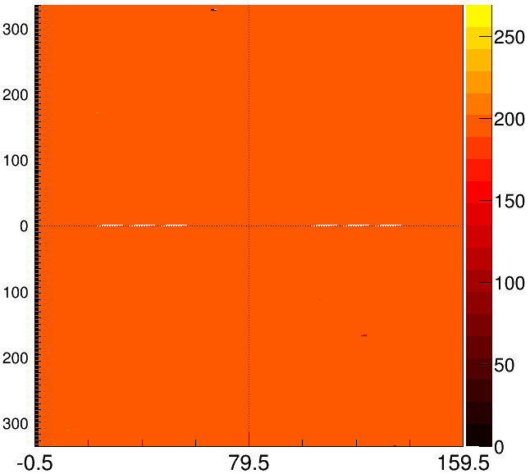
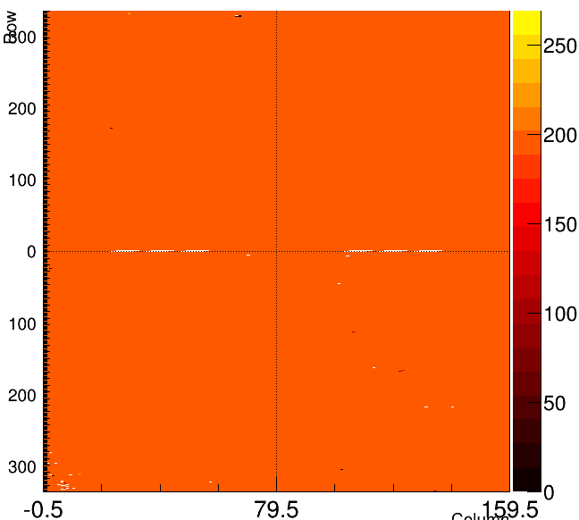
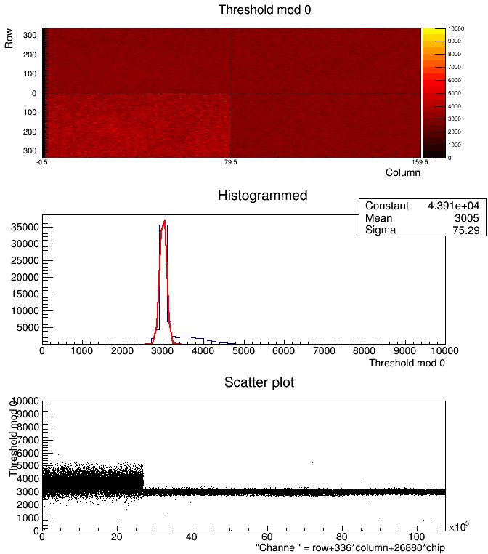
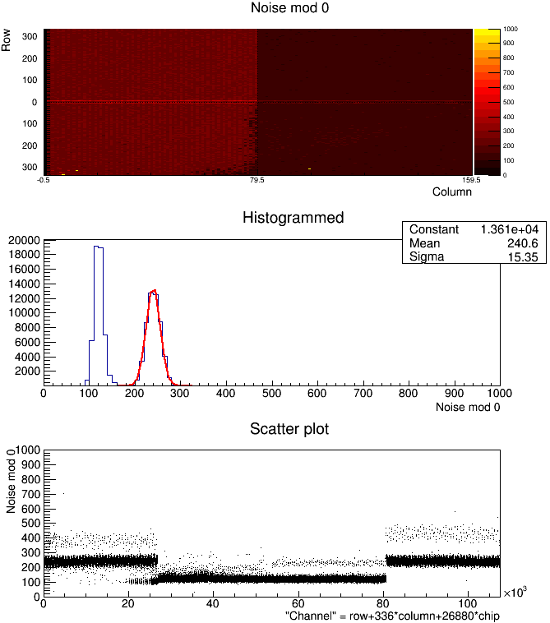
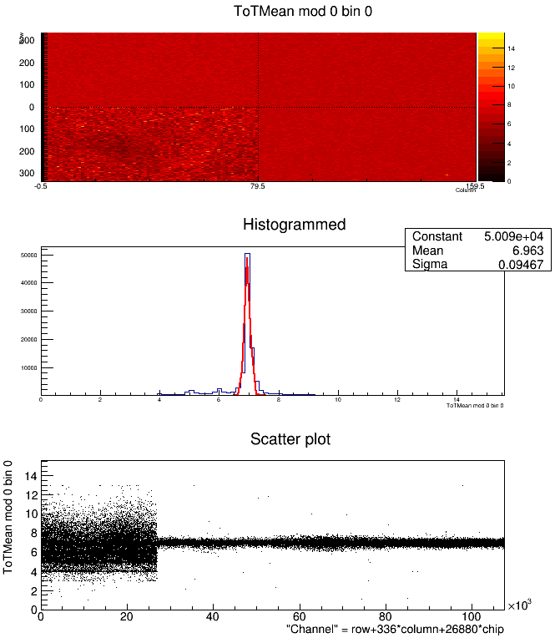
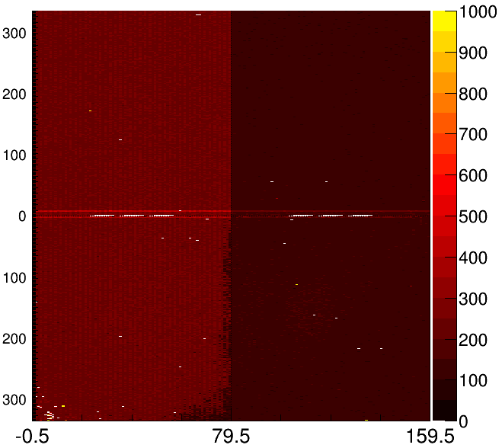
KEK101 Tuning (after TC)
Digital Test | Analog Test | Threshold Mean
Threshold Sigma | TOT Verif | Threshold sigma map

Slide 7
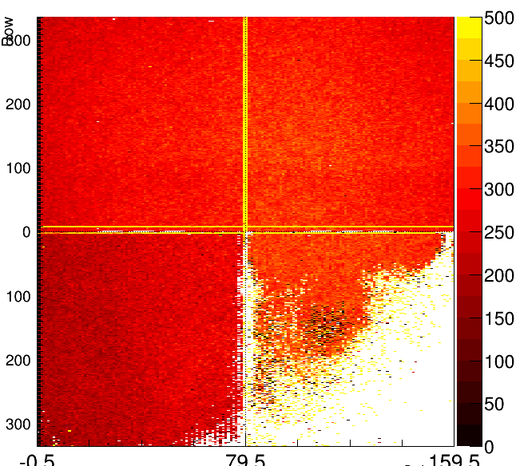
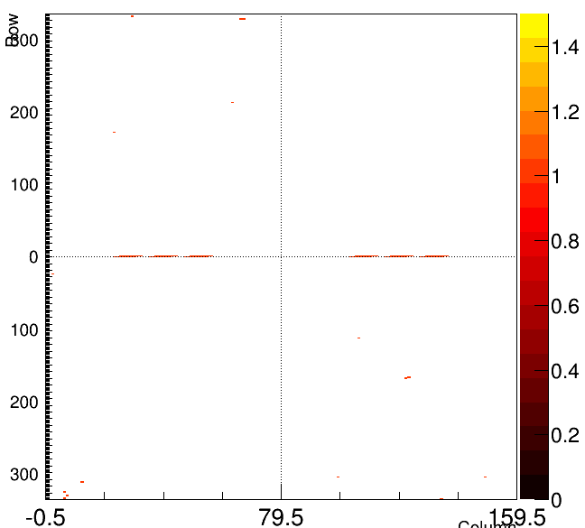
KEK101 Source Scan (100V)
Source Scan | Mask

Slide 9
Before parylene

Slide 10
KEK101 Tuning (before TC)
Digital Test | Analog Test | Threshold Mean
Threshold Sigma | TOT Verif | Threshold sigma map

Slide 11
KEK101 Source Scan (100V)
Source Scan | Mask

Slide 12
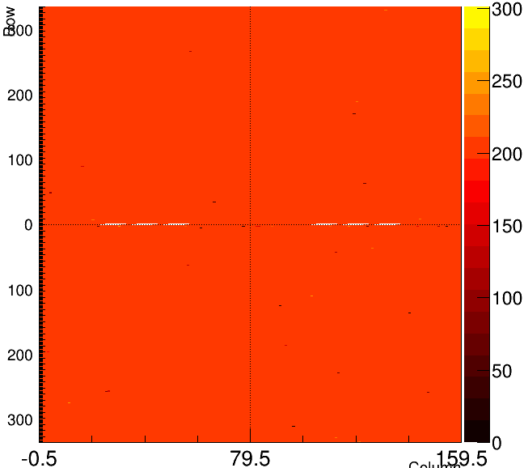
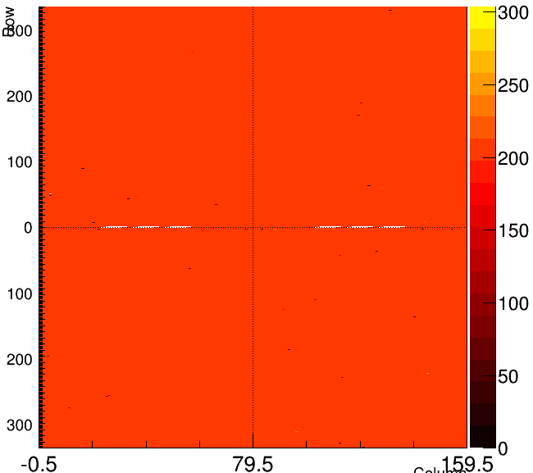
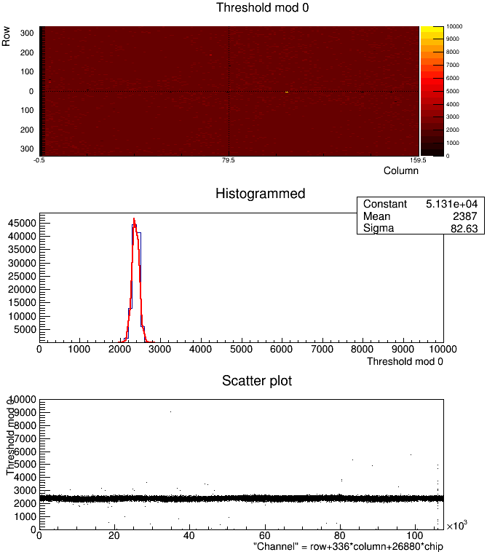
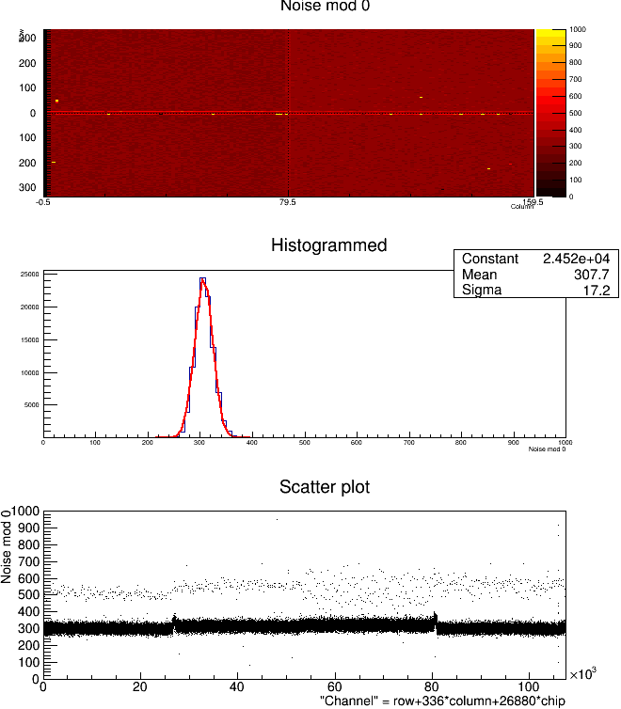
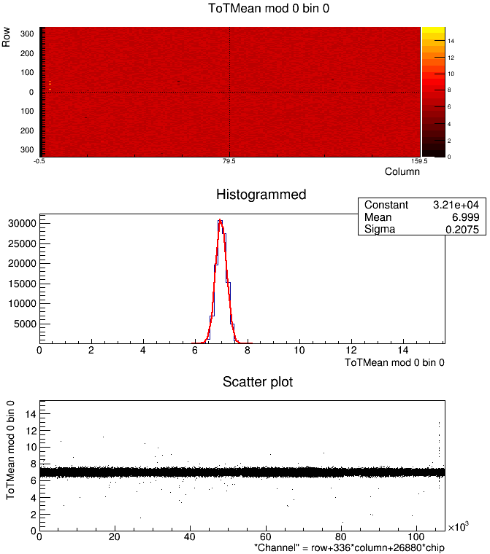
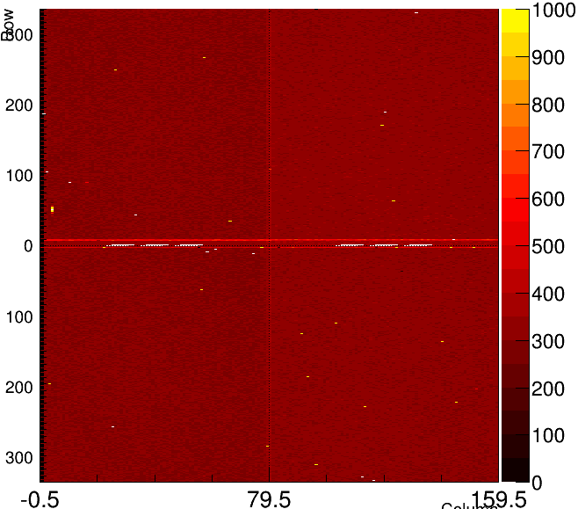
KEK102 Tuning
Digital Test | Analog Test | Threshold Mean
Threshold Sigma | TOT Verif | Threshold sigma map

Slide 13
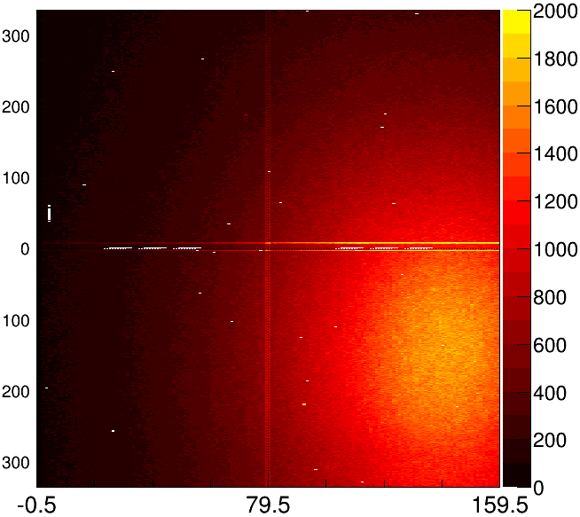
KEK102 Source Scan (100V)
Source Scan | Mask

Slide 14
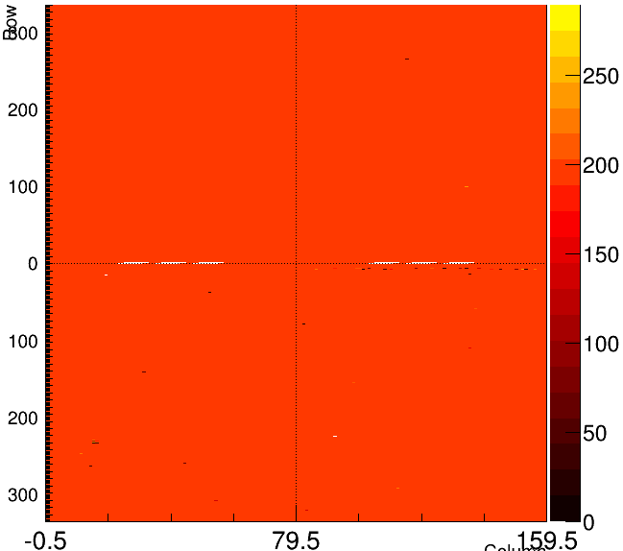
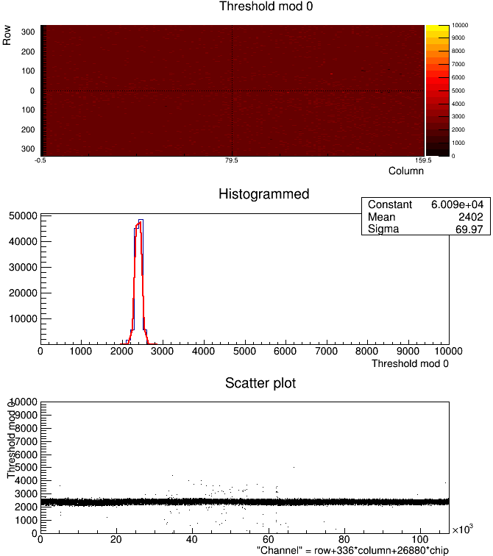
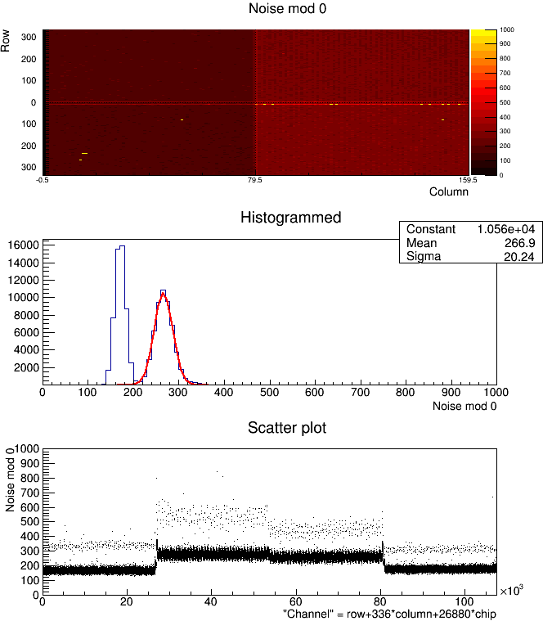
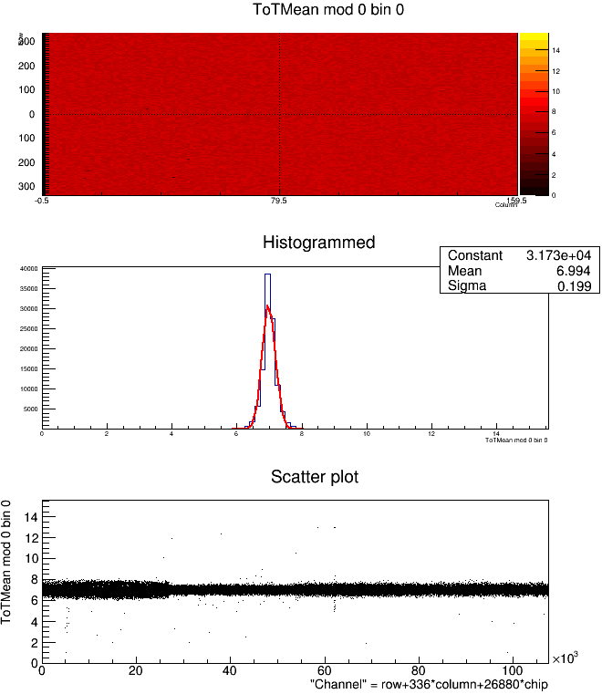
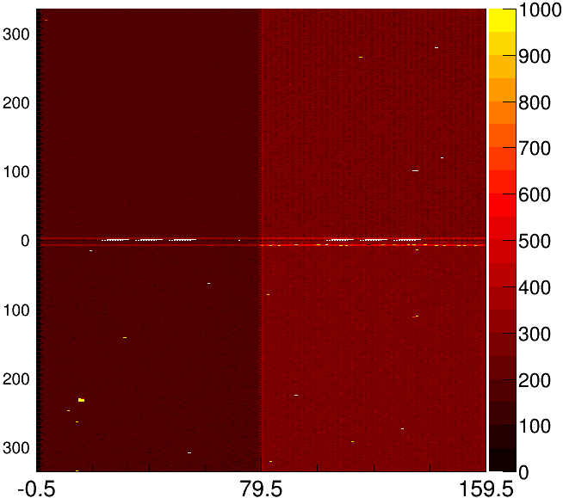
KEK103 Tuning
Digital Test | Analog Test | Threshold Mean
Threshold Sigma | TOT Verif | Threshold sigma map

Slide 15
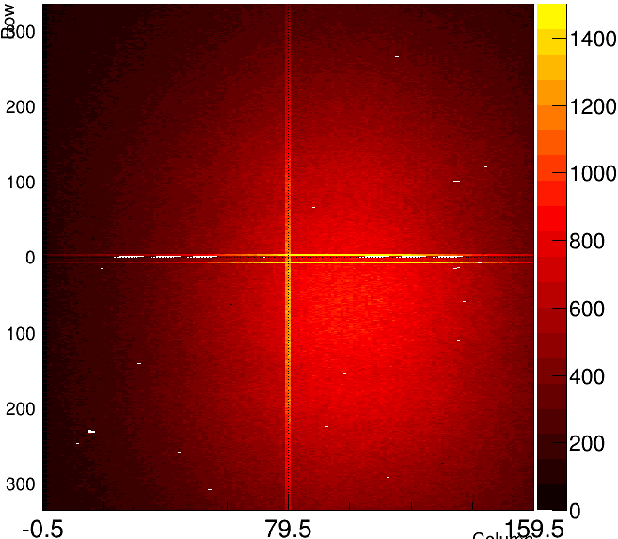
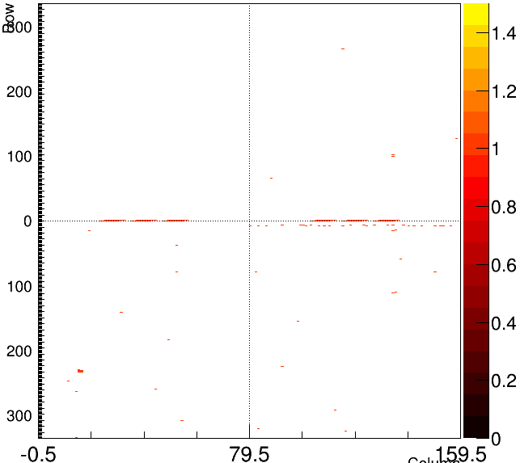
KEK103 Source Scan (100V)
Source Scan | Mask

Slide 16
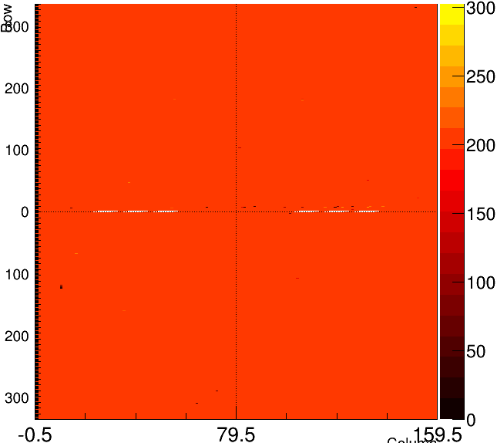
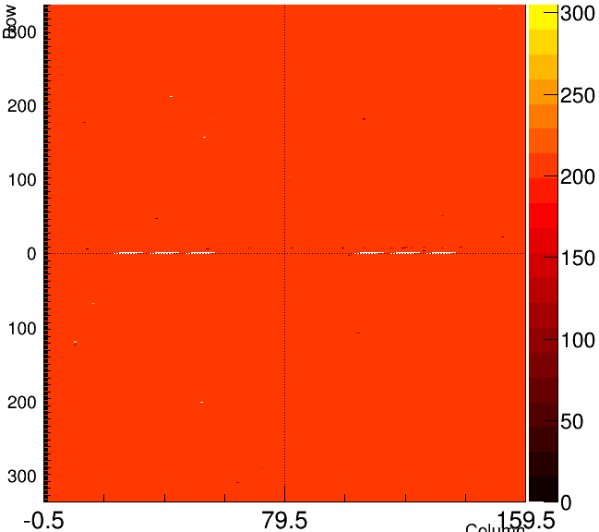
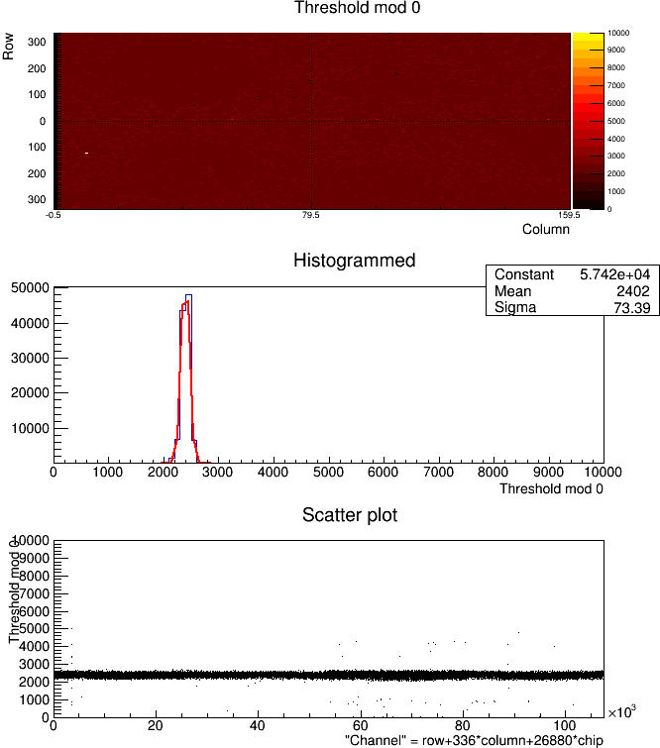
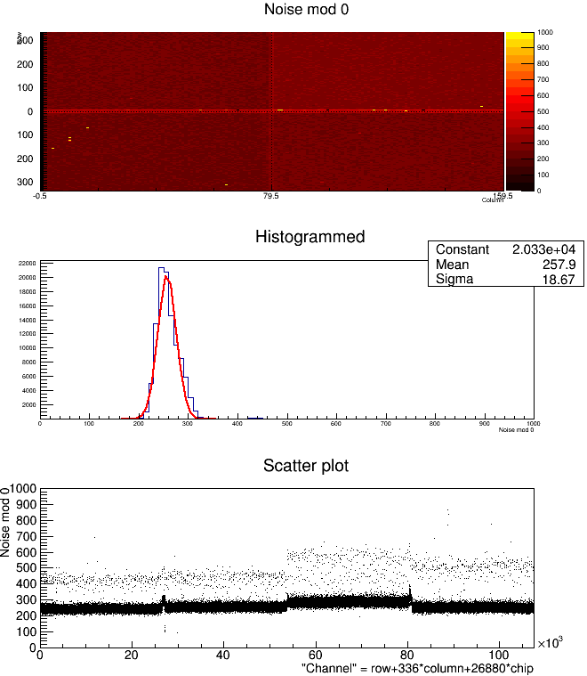
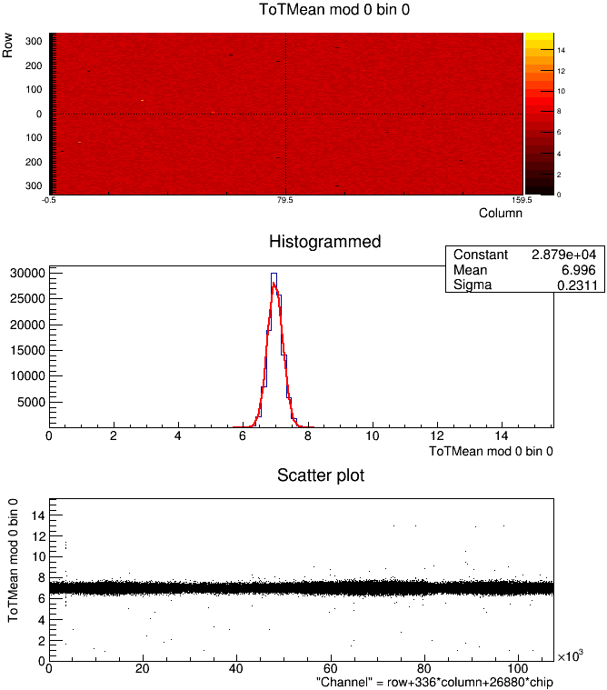
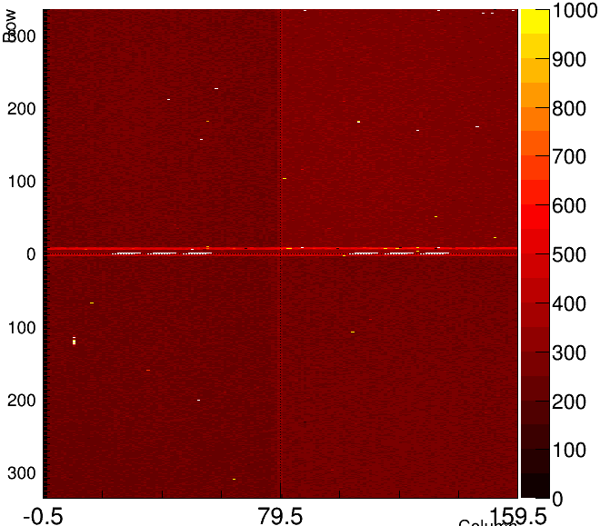
KEK104 Tuning
Digital Test | Analog Test | Threshold Mean
Threshold Sigma | TOT Verif | Threshold sigma map

Slide 17
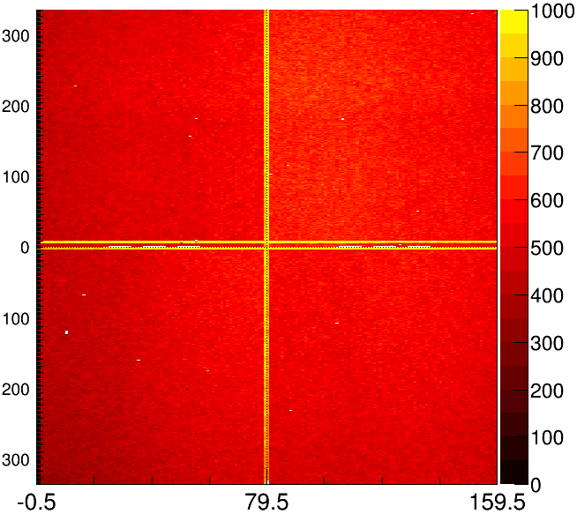
KEK104 Source Scan (100V)
Source Scan | Mask

Slide 18
After Thermal Cycle

Slide 19
KEK101 Tuning
Digital Test | Analog Test | Threshold Mean
Threshold Sigma | TOT Verif | Threshold sigma map

Slide 20
KEK101 Source Scan (100V)
Source Scan | Mask

Slide 21
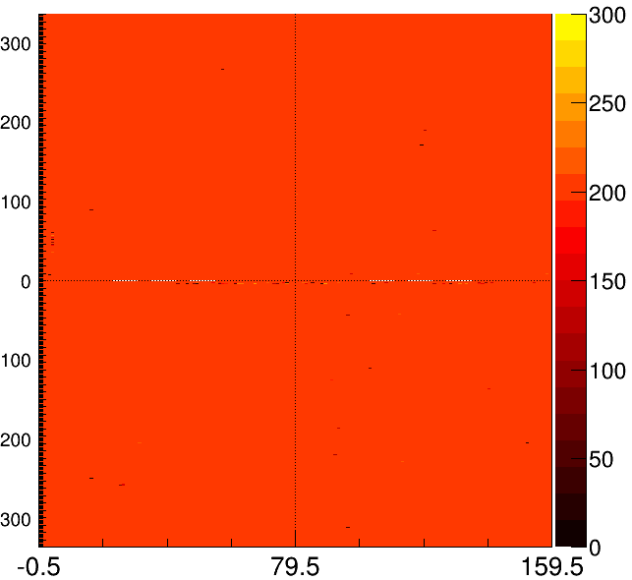
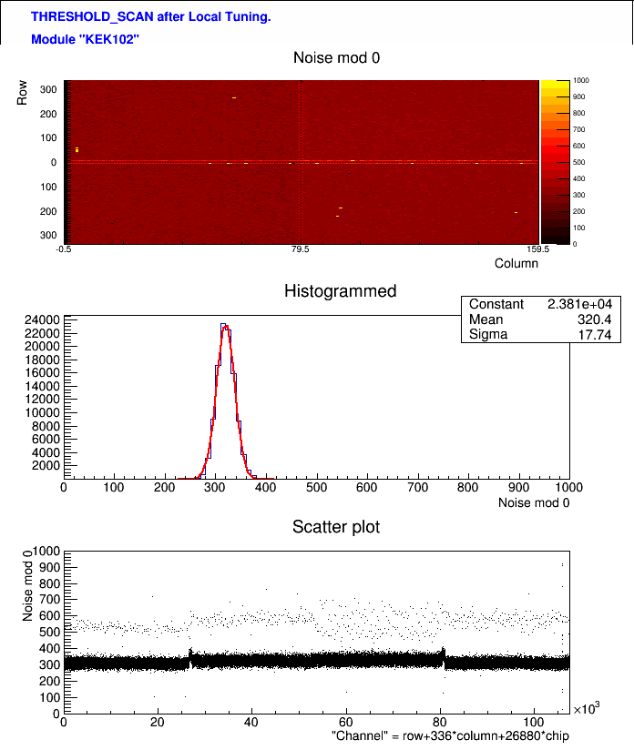
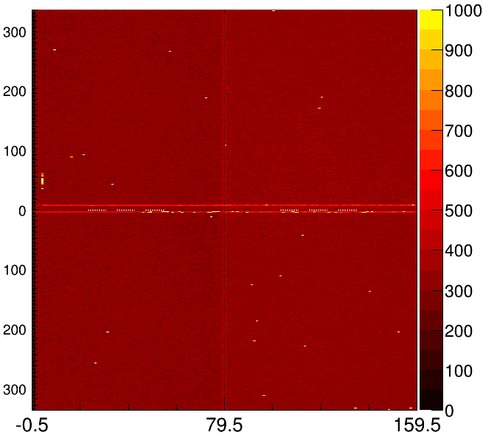
KEK102 Tuning
Digital Test | Analog Test | Threshold Mean
Threshold Sigma | TOT Verif | Threshold sigma map

Slide 22
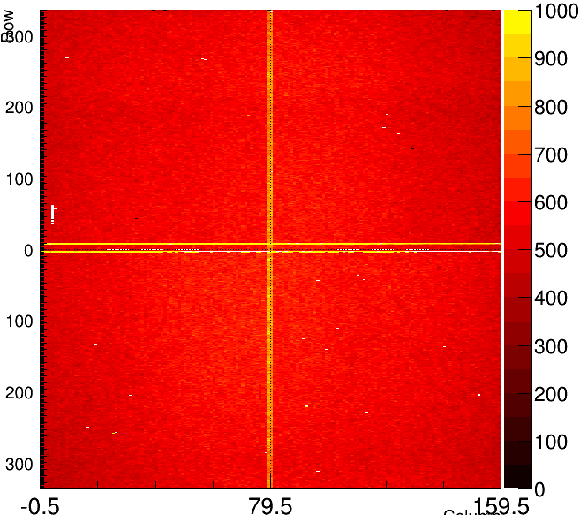
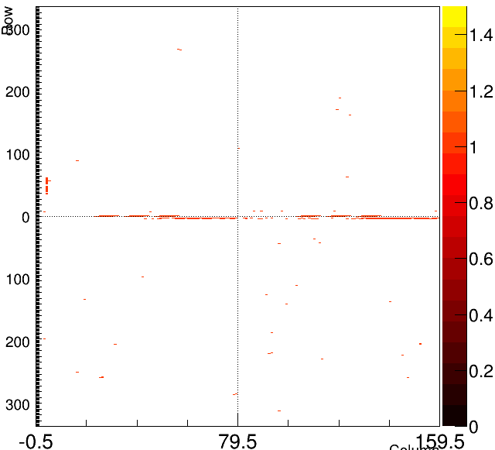
KEK102 Source Scan (100V)
Source Scan | Mask

Slide 23
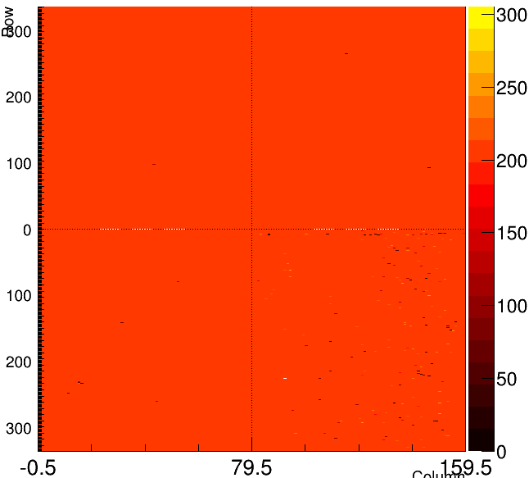
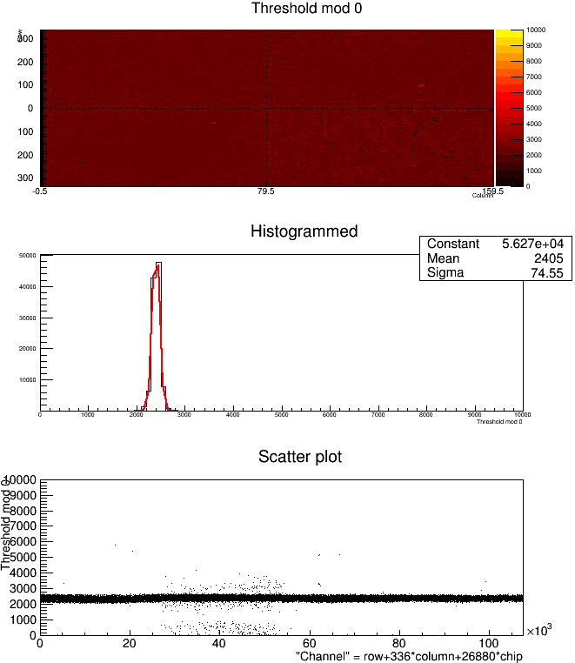
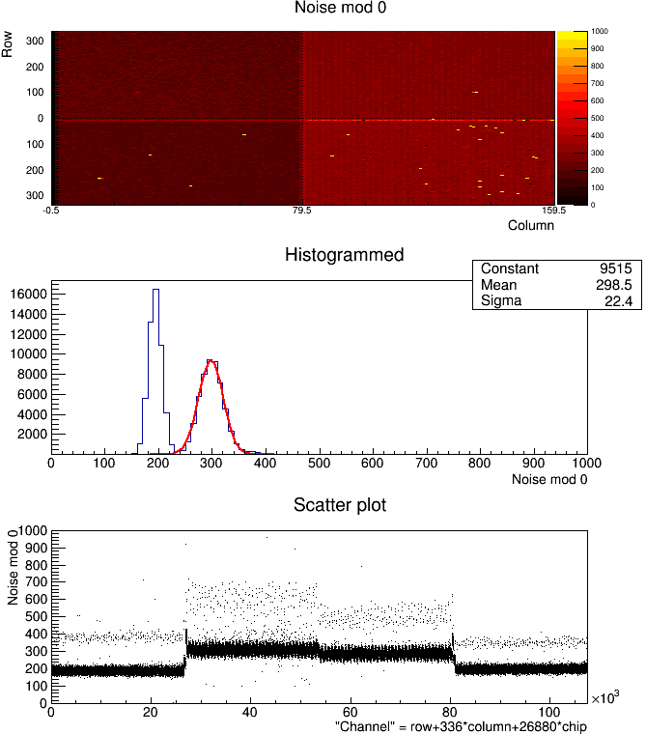
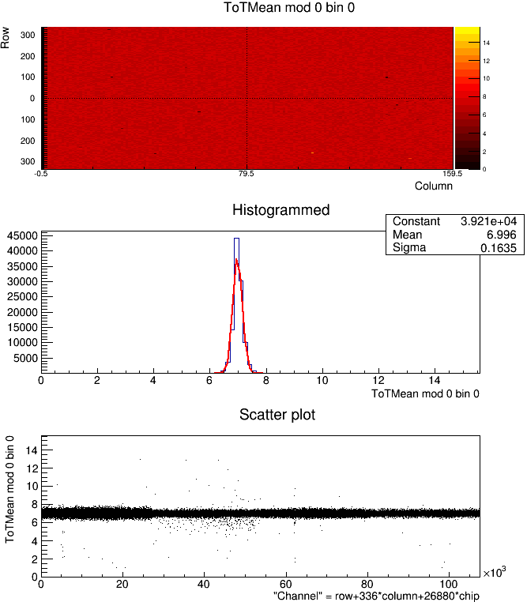
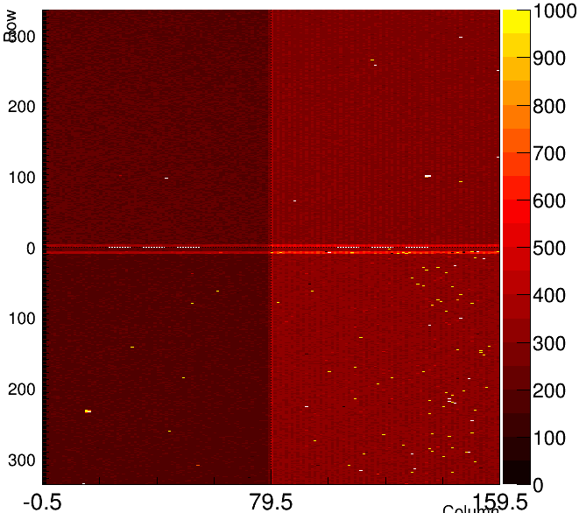
KEK103 Tuning
Digital Test | Analog Test | Threshold Mean
Threshold Sigma | TOT Verif | Threshold sigma map

Slide 24
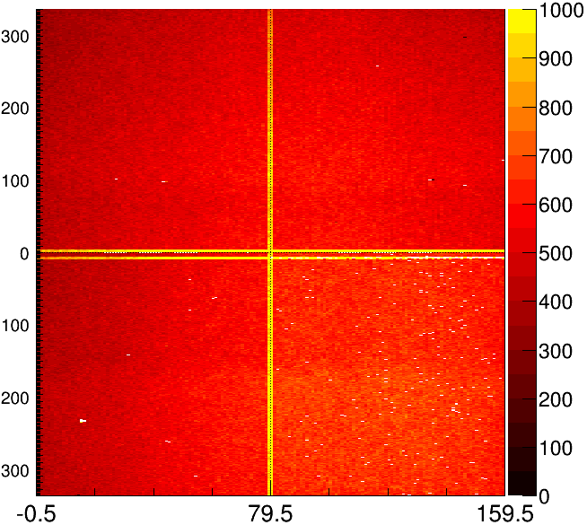
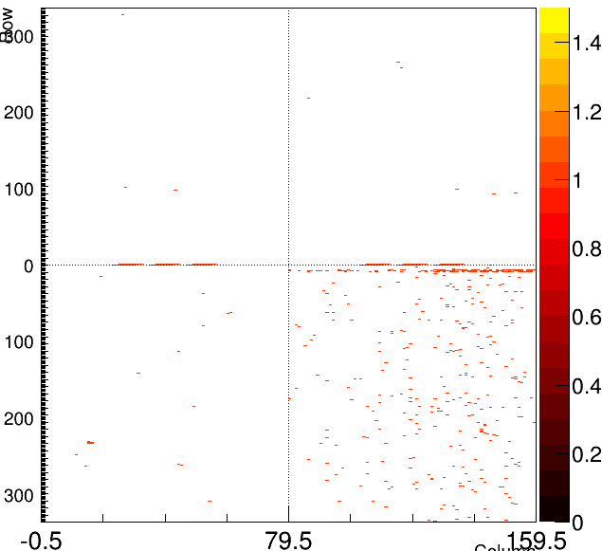
KEK103 Source Scan (100V)
Source Scan | Mask

Slide 25
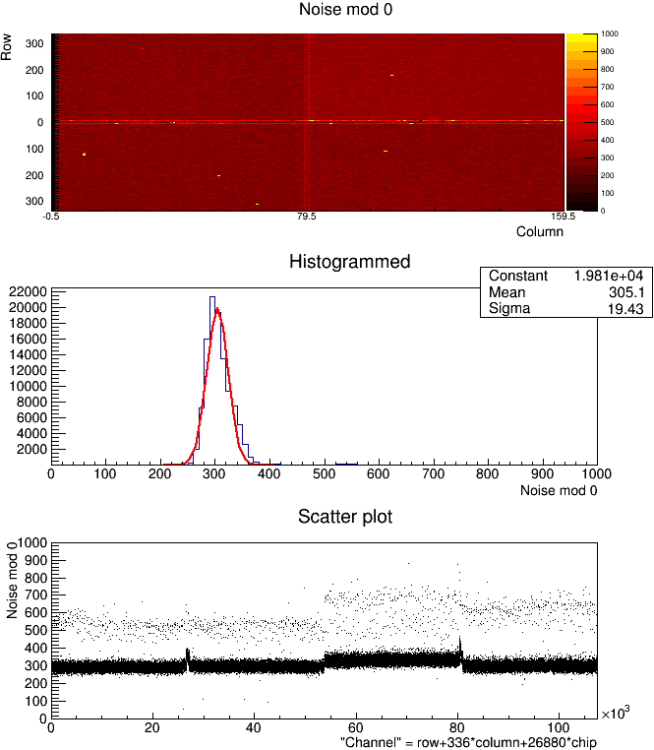
KEK104 Tuning
Digital Test | Analog Test | Threshold Mean
Threshold Sigma | TOT Verif | Threshold sigma map

Slide 26
KEK104 Source Scan (100V)
Source Scan | Mask

